Slide 1

MOBILE APPLICATION Development (114155)
Dr. Owais Hussain

Slide 2

Agenda
HTTP/HTML
Languages
HTML
Web Server
Web Browser
Pathway to React Native
Request and Response
Activity

Slide 3
Sample 2
HTTP/HTML
Origins of Hyper-text
HTML5. A giant leap.
Reducing overlap between mark-up, styling and scripting
Meaningful tags
Responsiveness
Support for media plug-ins
HTTP. Just another protocol?
What’s with the ‘S’ in HTTPS?
Notes:
The idea of hypertext originated from news editors. The editors used to put tags wherever corrections were needed in a report or article.
HTTP is just another protocol like FTP. It’s faster due to parallel channels, uses different ports, is stateless, and doesn’t require authentication.

Slide 4
Sample 2
Languages
eXtensible Mark-up Language
JavaScript Object Notation
JavaScript
Cascading Style Sheet
Visual Basic Script
Server-side languages:
Java Server Pages
Active Server Pages . Network Enabled Technologies
Personal Home Page
Ruby on Rails
And of course, Node. JavaScript
Notes:
Not all in the list are programming languages
We’re stuck with XML as legacy language
JSON is the 2nd most compact, behind only YML
JS is the future
CSS is not a language, it’s more like a specification represented in JSON-like syntax
VBScript: still breathing, thanks to MS-Office. It does deserve some credit for being the first one to execute on both server and client-side
JSP is passe
ASP.NET is Microsoft world
PHP should be avoided wherever possible due to its bad programming practices
Ruby is dynamic, simple, object-oriented, general-purpose language. Rails is the framework for web
Node.JS is full-stack Javascript

Slide 5
Sample 2
HTML
HyperText Markup Language
Written in XML, identified by <!DOCTYPE html>
Tags:
Html: Required to define document boundaries
Head: Not shown on page. Used to define metadata
Body: Everything to be displayed
Script: Javascript, jQuery, VBScript, …
Can contain content, style and script in single file. Not advised though
Supported by all personal and commercial platforms today
Notes:
HTML was created by Timothy Lee.

Slide 6
Web Server
A Software (yes) that provides content against a client request.
It is identified by a globally unique IP Address, often masked by a domain name.
The communication happens over HTTP on designated ports.
The content is provided in HTML.
A Web Server hosts one or more web applications.
Apache Tomcat, NGINX, IIS.
Creates Sessions (literally, nothing more than a temporary passcode).
Receives a “request” object and returns a “response” object.
Tip: It is a bad -- yet very common -- idea to use in-memory cache to keep session information on the same server where web server is hosted. Why?

Slide 7
Sample 2
Web Browser
A software installed on client’s computer. It’s OS-specific
Makes requests to web servers via a URL and renders the received response to display on its interface.
Engine: the heart of a web browser, responsible for encoding user's input into HTTP request, and rendering the response. It also creates layout and manages security.
Scripting Engine: executes client-side scripts on HTML pages via called DOM’s.
Cookies: the cache memory to store client’s data temporarily.
Cookie safety. A big challenge.
Notes:
Browser engines: Google/Edge=Blink; Apple=WebKit; Mozilla=Gecko
Scripting engine: Google=V8; Mozilla=SpiderMonkey; Apple=JavascriptCore

Slide 8
Sample 2
Pathway to React Native
React Native is a rip-off of React JS
React JS is a JavaScript library
JavaScript meaning ECMA-Script Standard Version 6 (ES-6)
JS-ES6 additions to compete with server languages. E.g.:
Inclusion of classes, const, arrow functions, default parameters
Importing and exporting resources
Promises for Asynchronous calls
Read more here: http://www.w3schools.com/Js/js_es6.asp
JavaScript is enclosed in Tags. React and React Native also have Tags like HTML
Styling is in CSS
Notes:
European Computer Manufacturers Association (ECMA)

Slide 9
Sample 2
Request and Response
HTTP Request is generated by client
Web Server: decrypts the package, checks for the URL and routes to the respective web application (this is simplification of an otherwise complex operation)
API (Controller, Service, Data Access layers):
Receives and authenticates client’s request, transforms data into back-end compatible objects.
Applies domain-specific business logic. Provides CRUD operations
Provides ORM and applies data logic like authorization, level of access, integrity checks
Web Application generates HTTP Response object and returns to client
Web Browser downloads the Response and renders on its interface

Slide 10
Sample 2
Request and Response
Example: a student wants to enroll in a course. He logs into the university’s LMS and choses a course
The Web Server receives the following packet:
Header: POST /addcourse.html HTTP/1.1 User-Agent: Mozilla/4.0 (compatible; MSIE5.01; Windows NT) Host: https://lms.kiet.edu.pk/ Accept-Language: en-us Accept-Encoding: gzip Content-Type: application/x-www-form-urlencoded Connection: Keep-Alive
Body:
studentId=CS-0433&courseId=CS224&username=imranali0433&password=Khuljasimsim

Slide 11
Sample 2
Request and Response
After the Web App has processed the Request, the following HTTP Response object is returned to client by Web Server:
HTTP/1.1 200 OK
Date: Sun, 07 Oct 2023 10:15:00 UTC+5
Server: Apache/2.2.14 (Win64)
Last-Modified: Sun, 07 Oct 2023 10:15:00 UTC+5
Content-Length: <packet length>
Content-Type: text/html
Connection: Closed

Slide 12
Sample 2
LET’S BEGIN

Slide 13
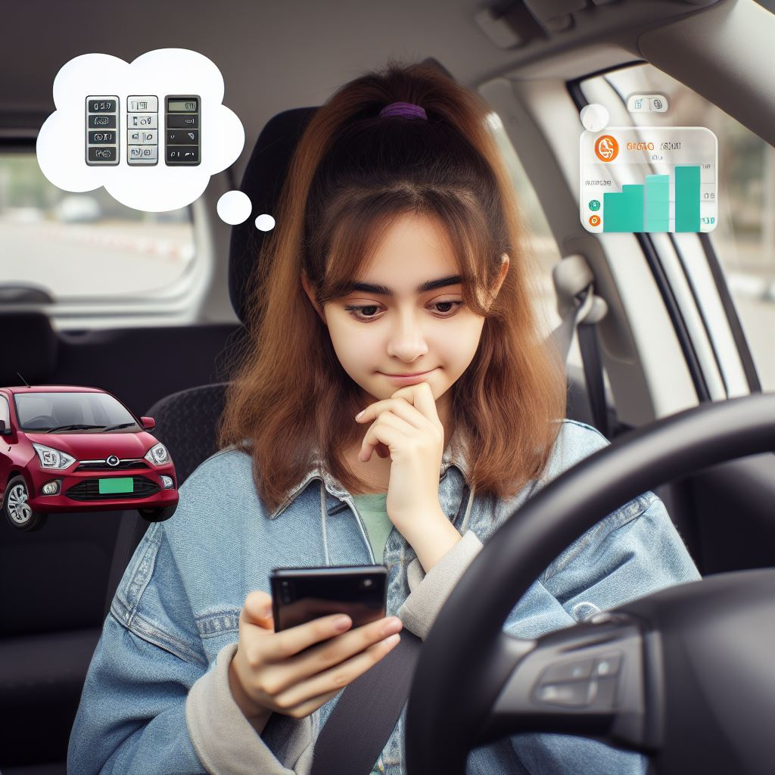
Sample 2
Sarah’s problem
Sarah commutes to university on her maroon Daihatsu Cuore.
She has a capacity for three extra people in a car but the three people who she can accommodate have to either live near Ayesha Manzil, where she commutes to and from, or situate somewhere within the route she takes.

Slide 14
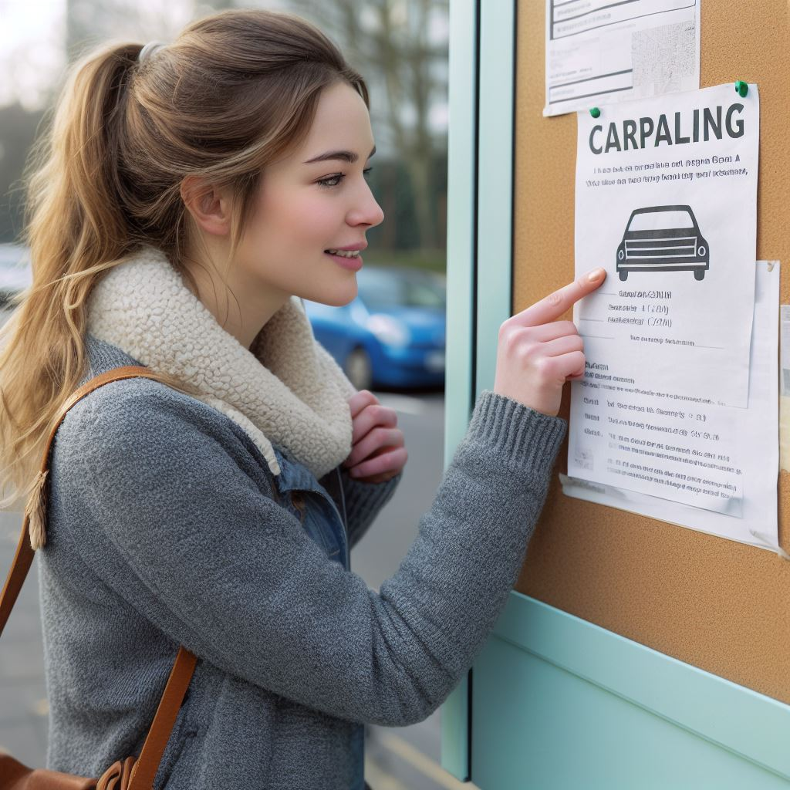
Sample 2
Sarah’s problem
She is thinking about minimizing her fuel expense as well as the environmental effects and decides to post an ad on university noticeboard so that other people can contact her to share the ride.

Slide 15



Sample 2
Sarah’s problem
Nabeel, the tuck-shop cashier, Dr. Imran from faculty, and a student from another college Shaista, see this ad and contact Sarah.

Slide 16

Sample 2
Sarah’s problem
Sarah gladly welcomes them and the three start to travel together.
Nabeel lives nearby, so he is the last one who gets picked and the first one to drop.
Shasta lives quite close to Sarah's place. However, she only joins on Mondays and Thursdays.
Dr. Imran lives near national stadium which is approximately at two third of the distance from university to Sarah’s place.

Slide 17
Sample 2
Sarah’s problem
After a while, things get slightly uneasy.
Nabeel is often not ready on time and kept the three waiting. He, on his side also has a valid complaint, that he is unfairly paying 25% of the fuel cost for a quarter of the distance.
Because of such matters, Sarah signs contracts with companions, including terms like schedule, share in the fuel and maintenance cost, start and end dates of contract.

Slide 18
Sample 2
Sarah’s problem
Halfway to the semester, Sarah terminates the contract with Nabeel as it was not cost effective; another of her classmates, Sidra requests to join, which Sarah accepts. Sidra lives at Shara-e-Faisal, therefore pays according to the distance.
Dr. Imran is quite happy; he likes the company and car. He ends up buying this car from Sarah therefore the car ownership transfers to him.
But there are still a dozen cars and 100 motorcycles left in the campus parking. Can we design a utility to systematically solve this problem for others?

Slide 19

Sample 2
Baham
The rest of this course will be centered around providing a solution to this problem.
The aim is to develop a cross-platform Mobile application – BAHAM (together), which can be used for in-campus ride sharing.

Slide 20
Sample 2
Activity
Create groups of 2 or 3 members.
You will be submitting a single html file at the end of the activity.
You will type in the entire page yourself. This step is important.
At the end of the activity, you will submit your file on LMS.
Keep in mind that you are designing for a Mobile interface. Think accordingly.

Slide 21
Sample 2
Activity
Create an HTML page which must display correctly on mobile interface. (420x320px)
Provide the required tags: <html>, <head>, <body>
In this single page, your objective is to add a Heading, sub-heading, Navigation bar, Main Section and Footer
Provide a heading, attach a favicon, provide Navbar links according to the scenario, place a few ads from Owners and Companions
All the content will be about the “Baham” app explained earlier
Provide Styling using on-page CSS
Make proper use of Padding, Borders and Margins

Slide 22



THANK YOU
Owais Hussain
+92 345-3174270
owais.hussain@kiet.edu.pk
https://www.researchgate.net/profile/Owais-Hussain-3

